Slide 1
TEAM MEMBERS: Akanksh K Narayana Akshat Parakh Jaskirat Singh Mythraye Vodnala Omkar Pandit Shreshtha Shukla
ANALYSIS OF THE PUBLIC PERCEPTION OF TRUMP PRESIDENCY

Slide 2
PROBLEM STATEMENT
WHAT?
Mr. Donald Trump became the president of the United States on January 20, 2017.
After almost a year into the role of President, we are analyzing the president's progress on his agenda and how it is received by the American public.
WHY?
Donald Trump came into office promising to change the face of American politics and transfer power "back to the people".
With a constant flow of news updates about the President and the uncertainty about what his actions will be in the future, we tried to interpret what the views of the people are, and what we can anticipate from the reactions of the people about the future.

Slide 3



SOURCES

Slide 4
STATISTICS

Slide 5
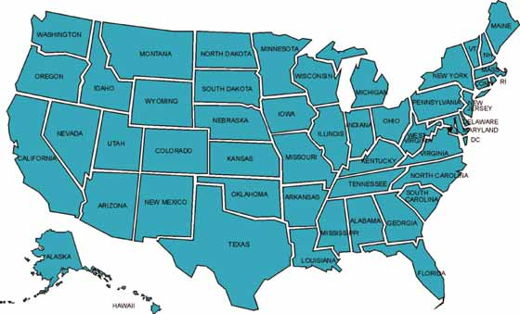



DATA COLLECTED
17,665 posts
2,489 posts
16752 tweets

Slide 6
WORD FREQUENCY
WORD | WORD FREQUENCY
MEDIA | 2056
TAX | 1575
TERRORISM | 1239
RUSSIA | 990
RACISM | 945
IMMIGRATION | 736

Slide 7
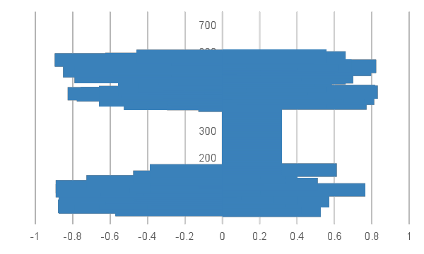
IMMIGRATION

Slide 8
ANALYSIS
Sentiment analysis shows that people don’t think that the issue of illegal immigration is being handled properly.
This was one of the major issues addressed in the Trump Presidential campaign.
The travel ban created a huge uproar in the country, with many people getting offended by the portrayal of the majority Muslim community being linked to terrorism.
The continued economic stress has influenced most people to become more negative about immigration, but the overall sentiment indicates that people are unhappy about the policies on immigration.
ADVICE
President Trump should handle the backlash from the various immigration policies by making sure that the policies that are put into effect to help Americans should not hurt the sentimentalities of the various cultural groups in America.
Comments, speeches, and tweets that are offensive to certain ethnic group or nationality should be avoided.

Slide 9
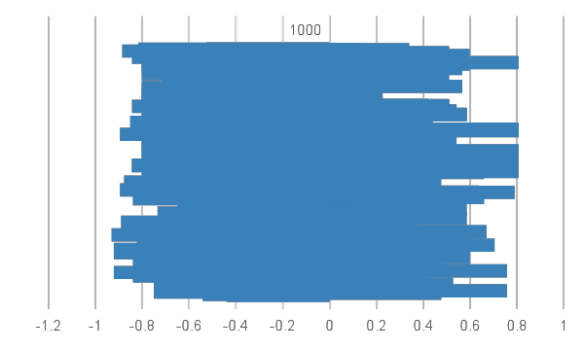
MEDIA

Slide 10
ANALYSIS
President Trump branding some news as fake can be one of the reasons that media has a negative perception of him.
The President is being criticized by mainstream news channels like CNN and NBC.
The constant attacks by Trump on media is harming his own image.
FOX news is being praised by Trump despite their credibility.
President Trump and news channels have been in war since his decision to run for President.
ADVICE
President Trump should build a better relationship with media and stop branding every bitter news about him as fake.
He needs to make sure that he portrays the image of the position he holds in the best light and thus, take some effort to improve his image in the eyes of the public.

Slide 11
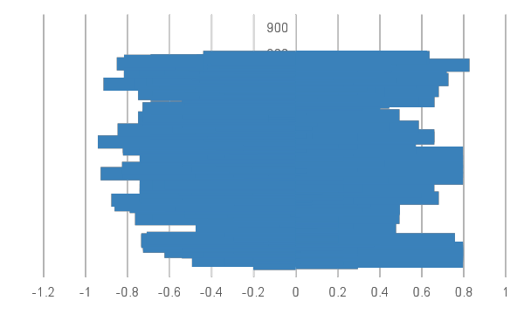
RUSSIA

Slide 12
ANALYSIS
Sentiment analysis shows, tweets about Trump and Russia are mostly neutral but slightly on a negative side.
This is because, real story of President Donald Trump and Russia is still unclear.
There’s no doubt that a spider web of connections some public, some private, some clear, some murky exists between President Trump, his associates and Russian President Vladimir Putin.
Recent twitter analysis clearly points out the discussions about Retired Lt. Gen. Michael Flynn, President Trump’s former national security adviser.
On December 1, Michael Flynn was found guilty with making false statements to the FBI. Tweets also show support to Muller’s careful Russia investigation.
ADVICE
The new Trump lawyer Ty Cobb and his team should tell every Trump family member, campaign operative, and White House aide to disclose every detail that might be relevant to the Russian investigations.
Whatever short-term political damage this might cause couldn't be worse than the death by a thousand cuts of selective leaks.
If there really is nothing to the Russian collusion allegations, transparency will prove it.

Slide 13
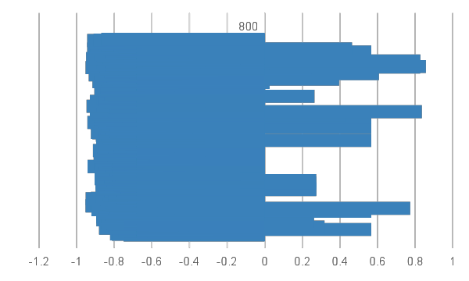
TERRORISM
Notes:
Negative sentiment

Slide 14
ANALYSIS
The analysis shows a strong negative sentiment for President Trump and Terrorism.
The main reason for this can understandably be the increasing number of attacks and negligence incidents towards families of troops deployed all over the world.
Also, people are talking a lot about the harsh defense treaties which are also affecting the economy of the nation.
The negative sentiment from the analysis seems to be in synchronization with a recent news article which says people are now becoming aware that President Trump’s defense policies are just more “Intensified” from Obama’s policies as opposed to what Trump claims to be “Revolutionized”.
ADVICE
Along with having a good marketing and a strong opinion, the policies need to be more practical, viable and less intransigent.
Notes:
Negligence towards families of troops. Harsh defence treaties. Trumps policies are more intensified as opposed to revolutionized. Practical policies.

Slide 15
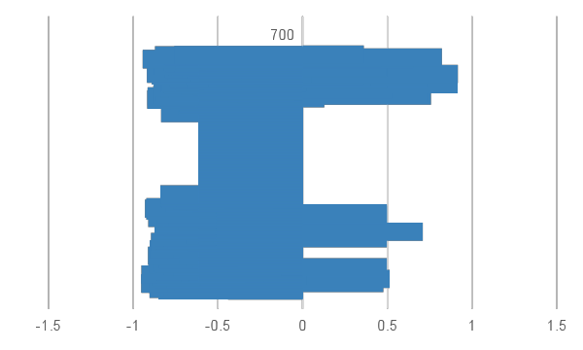
RACISM
Notes:
Negative sentiment

Slide 16
ANALYSIS
There is evidently a strong negative sentiment for President Trump being branded as racist.
This could be because of his huge support from KKK and other racist groups. Which he is not very willing to denounce.
He received huge criticism, when he failed to name the white supremacists or alt-right groups at the center of violent protests in Charlottesville, Virginia. But was vehement about NFL players kneeling for National anthem.
His attitude towards Islam has added fuel to this feeling, where he recently shared fake news by fringe British ultranationalist group purportedly showing Muslims committing act of violence, a move that was swiftly condemned by British PM as well as politicians across spectrum.
ADVICE
President Trump should start showing that he treats all groups equally in his words and actions.
He should not patronize minorities, but at the same time should defend rights of all the Americans.
He shouldn’t act impulsively, rather access all information and act correspondingly.
Notes:
Huge support from KKK and racist groups. Failure to react properly for protests in Charlottesville but reacted vehemently to NFL players kneeling.
Talk the talk but also walk the walk. Should

Slide 17
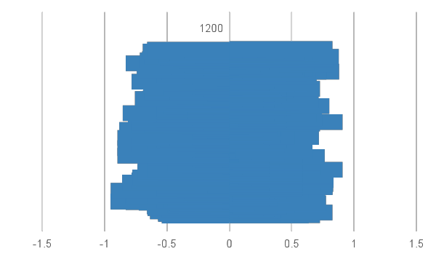
TAXES

Slide 18
ANALYSIS
Using sentiment analysis on the comments from various sources, we were able to see that the sentiment was slightly towards the positive side, majority being neutral.
Donald Trump has promised that there would be a major tax cut in this new bill. This is a hot topic now, as the new tax bill is on the verge of getting passed.
There has been mixed response till now with some articles claiming that the new bill would be influential to middle class people,while few other articles claim the new bill would be influential to wealthy people.
It would be quite interesting to see how the sentiments would change, once the bill is actually passed and people get to know whether the newly passed bill would help or hurt them.
ADVICE
The President has already mentioned many times that this would be the “biggest tax cut”.
The Republicans are giving a lot of statements about how the new tax bill would be beneficial to the middle class.
Although it is too early to speak, we would suggest that the President and the Republicans make sure that all the statements they are releasing about the benefits are actually present in the bill.
There has been a lot of mention about this being a tax scam in many articles, and if it is true, the President would have to face an outrage from the people.
The President and the Republicans should be vary of this possible scenario.

Slide 19
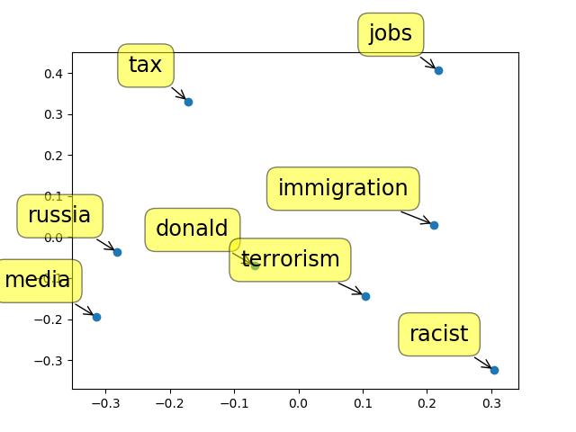

Slide 20
THANKS!
Any Questions???

